Slide 1

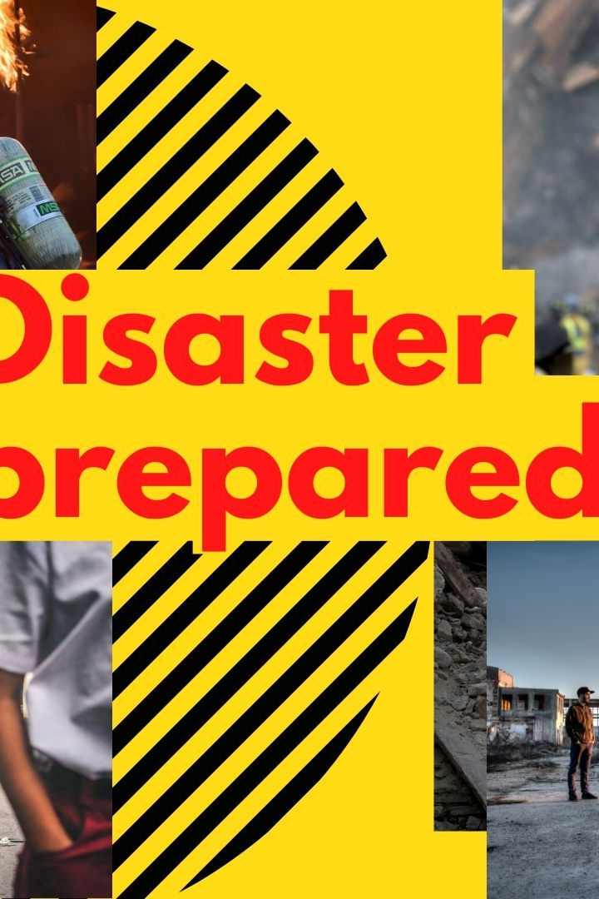

Disasters: Understanding the Risk and How to Prepare
Disasters can strike at any moment, but by taking steps to prepare and mitigate the impact, we can protect ourselves and our communities. This presentation will cover the risks and strategies for natural and man-made disasters.
by Mangesh Karande

Slide 2

Fighting Floods and Protecting Communities
The Risk of Flooding
Preventing Floods
Response Strategies
Flooding is one of the most common and devastating types of natural disasters, causing extensive damage to homes and infrastructure.
Preventing floods requires a comprehensive strategy, including building flood barriers and preserving wetlands and other natural water sources.
In the event of a flood, communities can take steps to evacuate, provide emergency supplies and medical assistance, and work to quickly repair the damage.

Slide 3
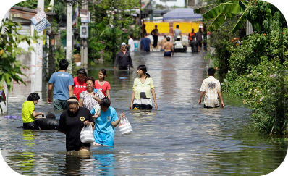
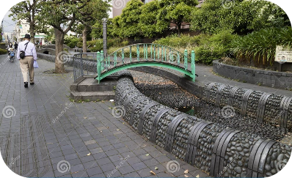
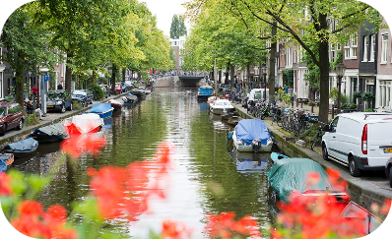
Effective Flood Management
Thailand's Flood Resistant Homes
Japan's Scenic Flood Drains
Oostvaardersdijk: The Dutch's Storm Barrier
Thais built amphibious houses using materials that float in water to stay afloat and avoid water damage.
Japan's curvaceous and aesthetically pleasing water relaxation spots also double as flood drainage areas.
The world's largest storm barrier keeps the Netherlands' four provinces safe from the sea, which is raised at 23 feet above sea level.

Slide 4
Understanding Man-Made Explosions
Type
Cause
Industrial explosions
Common causes include sparks, overheating, and failures in the manufacturing process.
Terrorist Attacks
Explosives used by terrorists that are not controlled by government regulation or oversight.
Accidental Explosions
Unintentional or unplanned explosions resulting from errors or negligence in storage, transport and handling.

Slide 5
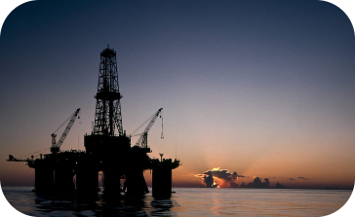
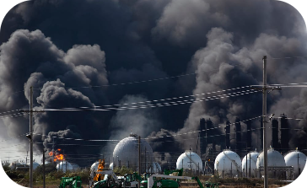

Examples of Effective Explosion Prevention
BP's Offshore Explosion
Tuticorin Copper Plant Explosion: A Lesson in Staff Training
Data Center Protection by Microsoft
British petroleum operates offshore facilities with high safety protocols. Their integrity test prevents explosions from occurring in the offshore platform where a lot of flammable gas is produced.
Tuticorin copper smelter team members had not been trained in hazardous waste storage or handling. The explosion resulted in 14 lethal casualties. Effective staff training is crucial in preventing such tragedies.
Microsoft uses advanced smoke detection, smart natural ventilation systems, and power redundancy measures to prevent explosion and maintain infrastructure continuity.

Slide 6
Controlling the Spread of Epidemics: A Public Health Challenge
1
What Are Epidemics?
Epidemics are highly contagious diseases that can quickly spread across communities and even continents.
Preventing Epidemics
2
Preventative measures include vaccinations, public health campaigns, and early detection through symptom monitoring.
3
Containing Epidemics
If an epidemic does arise, quick action is needed to contain the spread through contact tracing, quarantine measures, and medical treatment.

Slide 7
Cyclones: Preparation and Response Strategies
The Danger of Cyclones
Preparing for Cyclones
Responding to Cyclones
Cyclones are powerful storms that cause high winds, flooding, and large-scale damage in coastal regions.
Preparing for a cyclone requires a range of strategies, including storm-proofing homes, stocking emergency supplies, and developing a community plan.
In the aftermath of a cyclone, communities must work quickly to provide medical assistance, rebuild homes and infrastructure, and support those impacted by the storm.

Slide 8
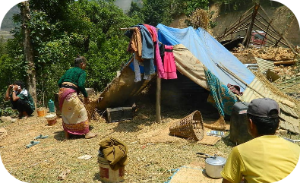
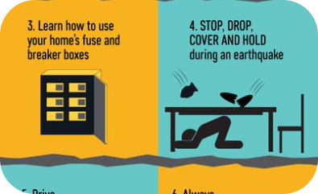
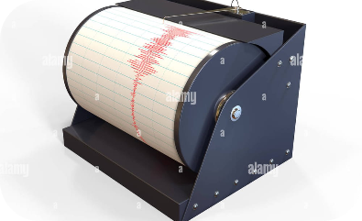
Earthquake Preparedness and Response Plans
Preparing for Earthquakes
Responding to Earthquakes
Measuring Earthquakes
Scientists use seismographs to measure the magnitude and location of earthquakes, allowing communities to take appropriate action in the event of a quake.
Preparing for an earthquake requires a range of strategies, including securing heavy furniture, stocking emergency supplies, and identifying safe evacuation routes.
After an earthquake, communities must work quickly to provide medical assistance, shelter for those who lost their homes, and support for recovery efforts in impacted areas.

Slide 9
Ways to Mitigate and Manage Droughts
1
Understanding Droughts
2
Preventing and Managing Droughts
Droughts are prolonged periods of time with little precipitation, resulting in water scarcity and economic impacts.
Preventative measures include water conservation policies, sustainable farming practices, and reforestation efforts. In the event of a drought, communities can take steps to conserve water, promote water recycling, and support economic recovery efforts.

